Slide 1

Project Title – AIRBNB HOTEL BOOKING ANALYSIS PROJECT
[SHARMILAA V]
[INTERNSHIP_17546440516895be537820f]
[APPLY_175489717468999b16e5980]

Slide 2

PROBLEM STATEMENT
The hospitality industry has undergone a significant transformation with the rise of online platforms facilitating short-term lodging and tourism. Leading this revolution is Airbnb, Inc., a pioneering American company that has reshaped travel accommodation through its innovative online marketplace.
This research analysis delves into the New York City Airbnb dataset to extract meaningful insights. Through rigorous data cleaning, exploratory analysis, and visualization techniques, the study aims to illuminate the dynamics of the city's lodging market. By discerning factors influencing listing availability, pricing strategies, and overall customer satisfaction, the research contributes to a deeper understanding of Airbnb's operations in one of the world's most dynamic urban environments.

Slide 3
Project Description
Objective: Analyze Airbnb hotel booking data to uncover patterns, trends, and insights.
Booking Patterns: Identify peak seasons, location-wise variations, and average booking lead times.
Pricing Strategies: Study effective pricing techniques, seasonal impacts, and the link between pricing and guest satisfaction.
Guest Preferences: Determine key amenities and features that influence guest ratings and preferences.
Host Performance: Evaluate top-performing hosts, their responsiveness, and common guest complaints.
Outcome: Provide data-driven recommendations to improve pricing, guest experience, and host efficiency.

Slide 4

WHO ARE THE END USERS?
Airbnb Hosts: To improve pricing, responsiveness, and overall guest satisfaction.
Property Managers/Owners: To optimize occupancy rates and maximize revenue.
Guests/Travelers: To benefit from better pricing, improved amenities, and enhanced booking experiences.
Airbnb Management/Business Analysts: To identify market trends, improve platform policies, and guide business strategies.
Hospitality Consultants/Researchers: To study market dynamics and provide data-driven recommendations for the hospitality industry.

Slide 5

Technology Used
Programming Language: Python (for data cleaning, analysis, and visualization).
Data Analysis Libraries: Pandas, NumPy (data processing and manipulation).
Data Visualization Tools: Matplotlib, Seaborn, Plotly (graphs, trends, and insights).
Database/Storage: CSV/Excel files (for storing and retrieving booking data).
Data Platforms: Google Colab (for analysis and reporting).

Slide 6
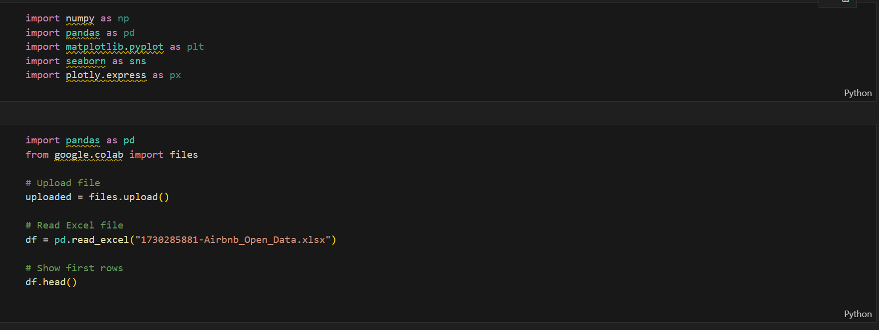
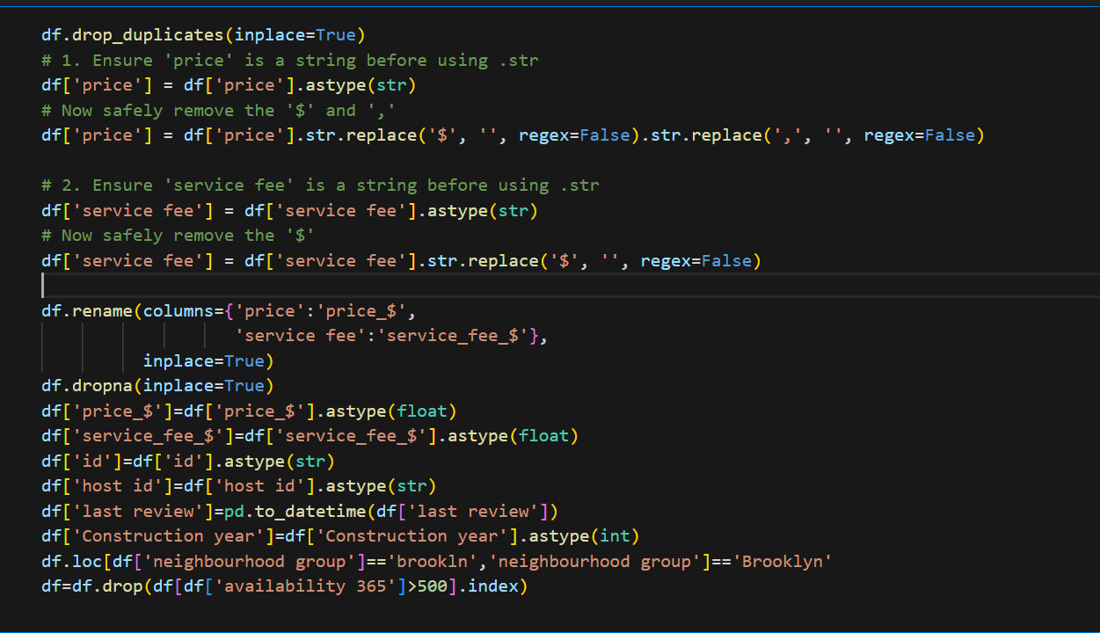
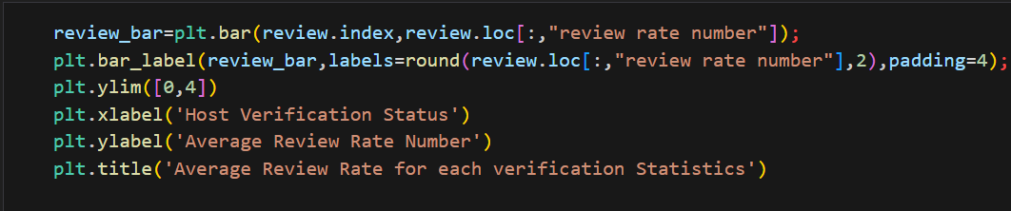
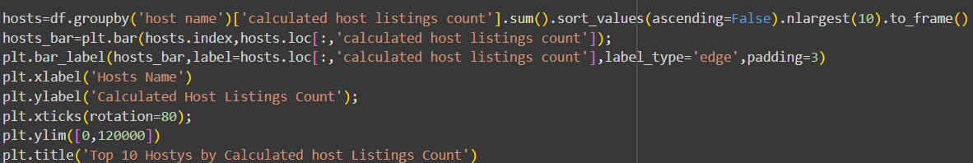
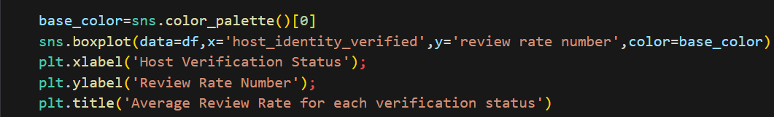
Python Code:

Slide 7
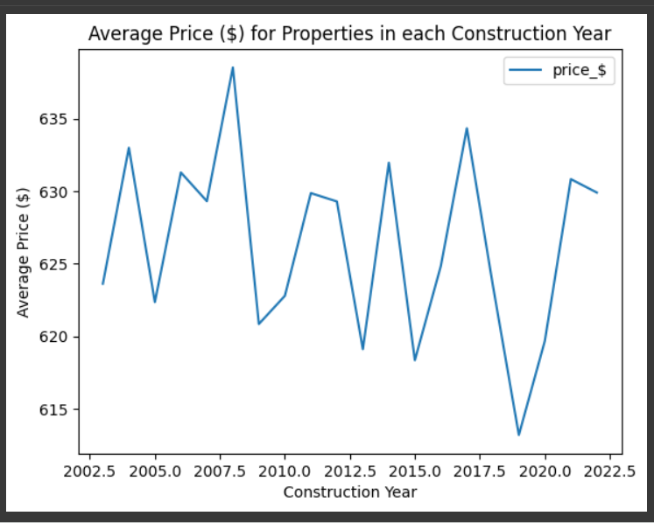
RESULTS1
[Add screen shots of your code or Chart(s) ]
Demo Link

Slide 8
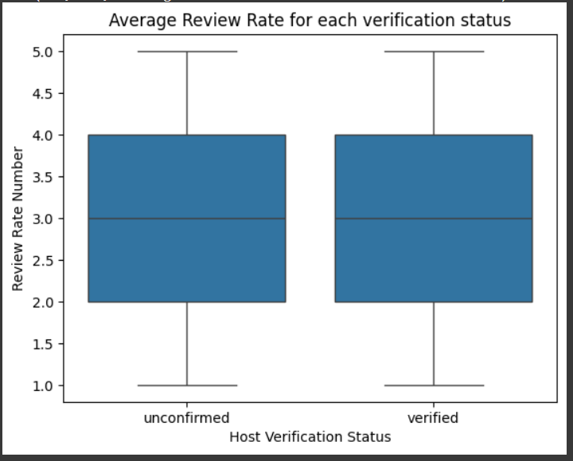
RESULTS2
[Add screen shots of your code or Chart(s) ]
Demo Link

Slide 9
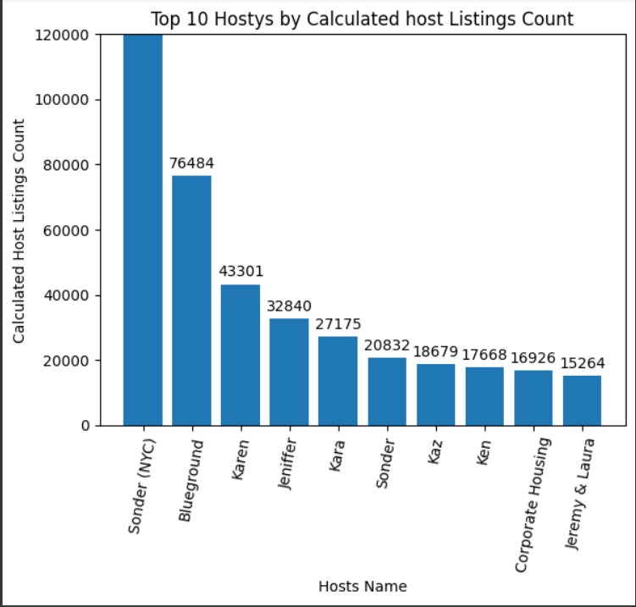
RESULTS3
[Add screen shots of your code or Chart(s) ]
Demo Link

Slide 10
GitHub repository
[https://github.com/Sharmilaa2004/VOIS_AICTE_Oct2025_Sharmilaa]
Demo Link

Slide 11
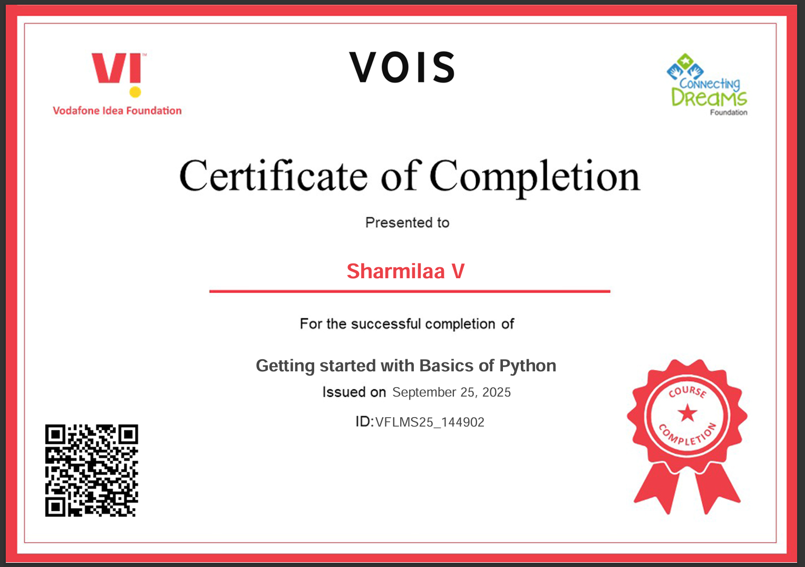
Getting started with Basics of Python Certificate
[Paste your Certificate Here]

Slide 12
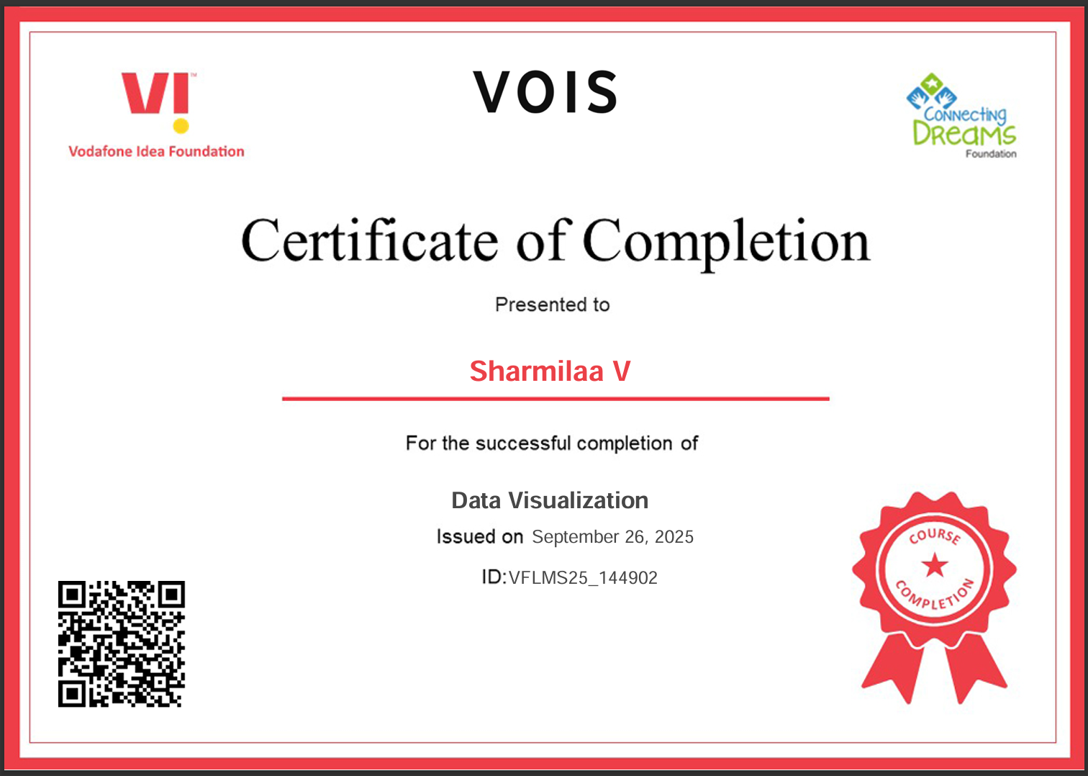
Data Visualization Certificate
[Paste your Certificate Here]

Slide 13
Thank you
.
.

